Slide 1
HR ANALYTICS

Slide 2
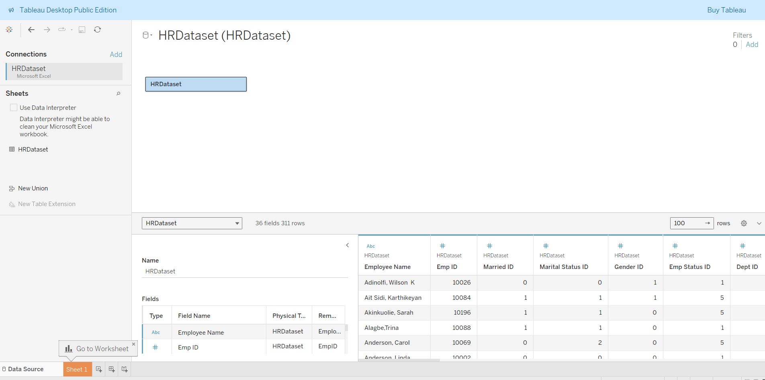
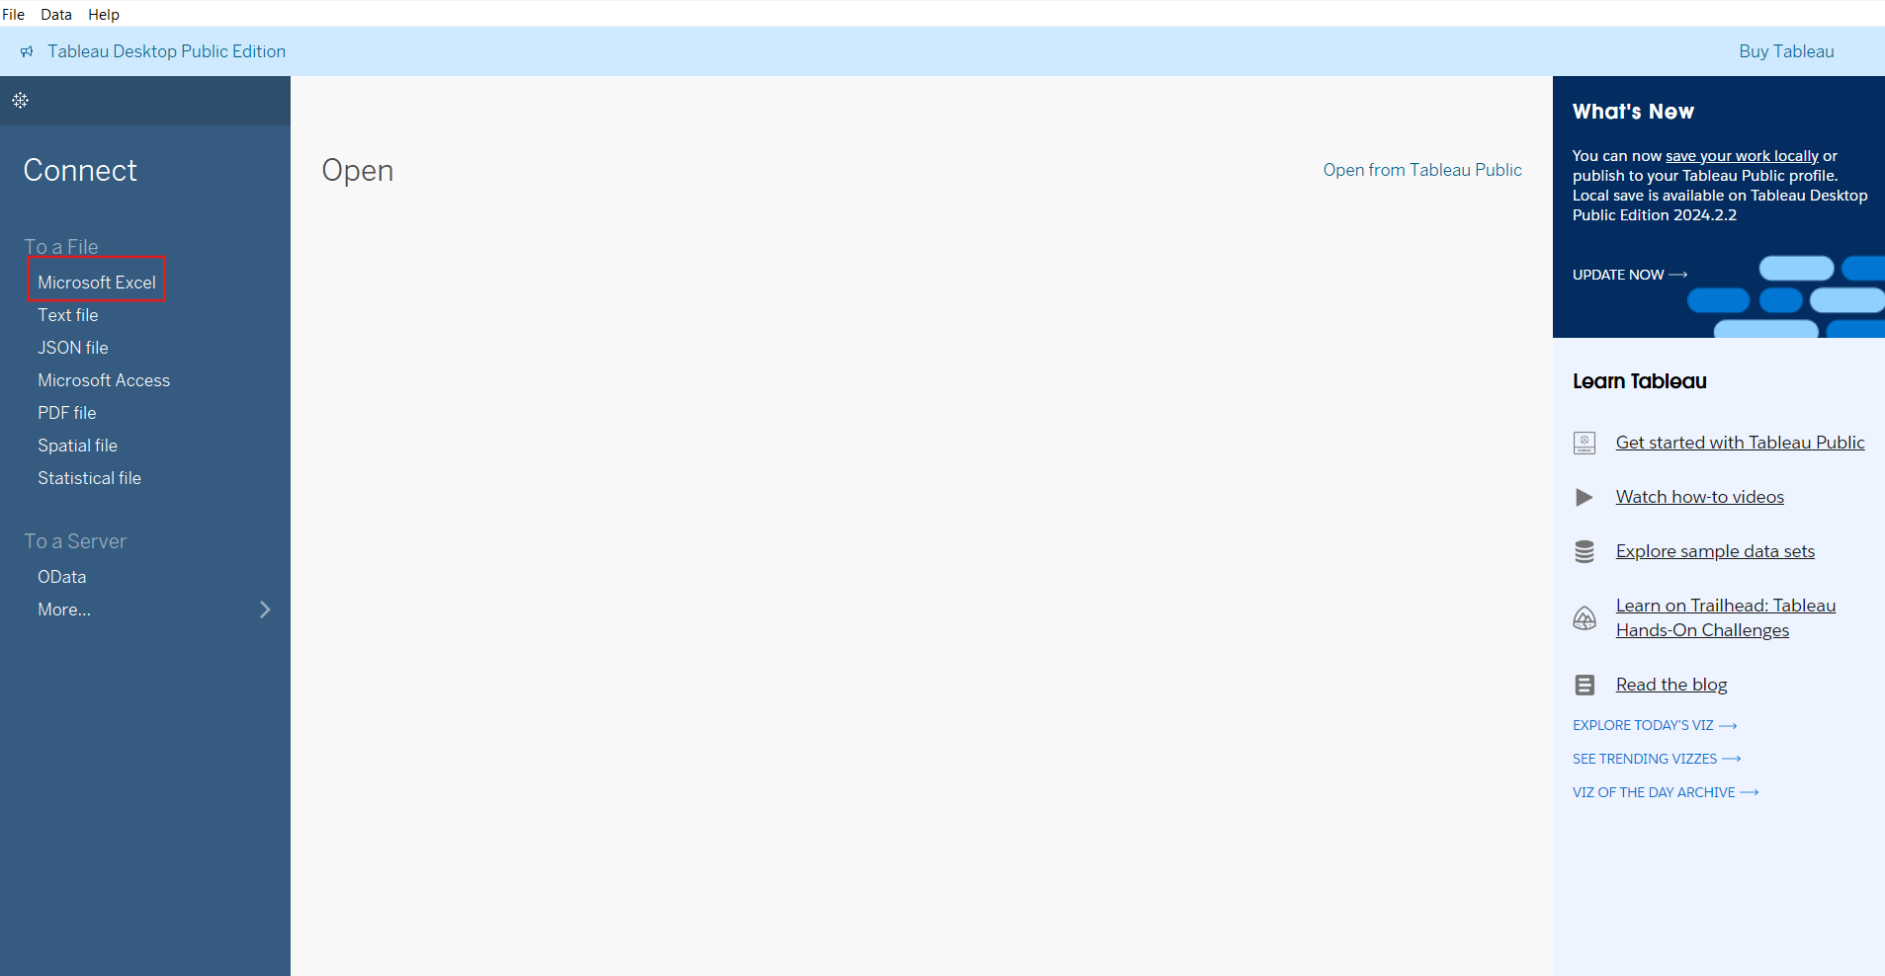
IMPORT FILE
Open tableau and click Microsoft excel.
Select the file and click ok.
The dataset will open.
Next we click on sheet 1.

Slide 3
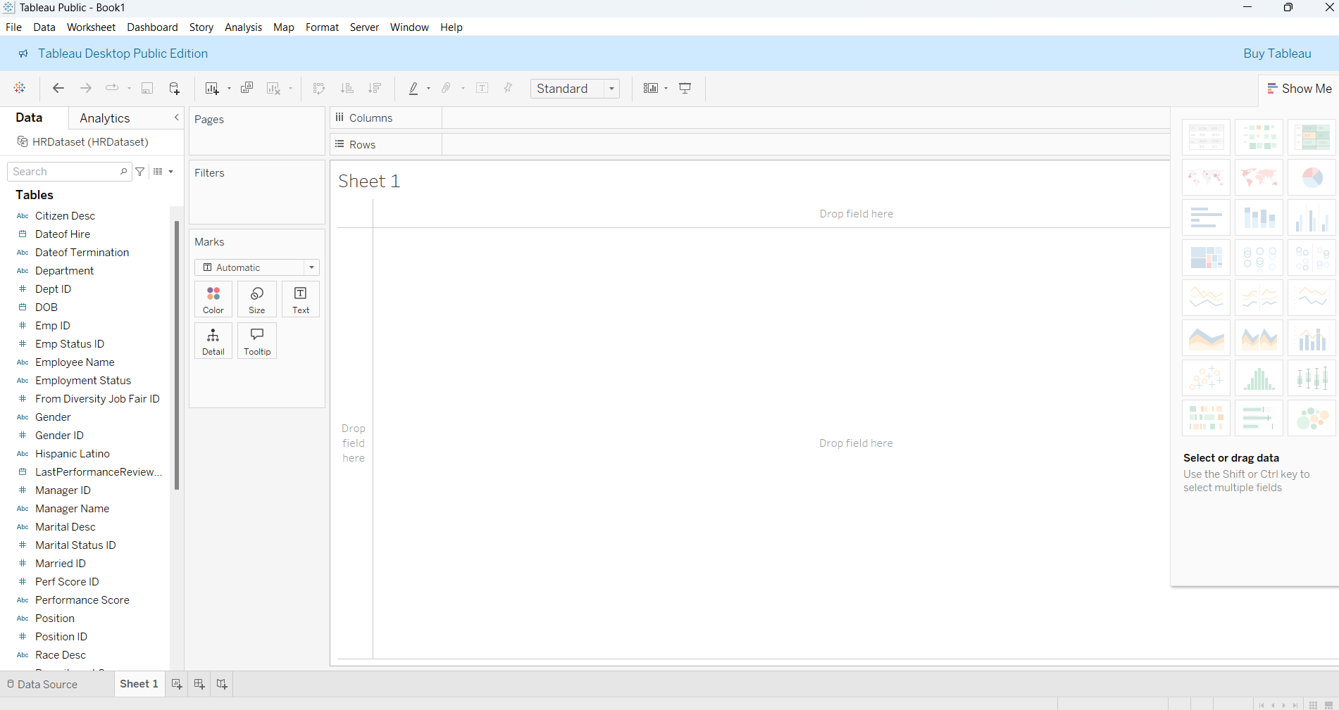
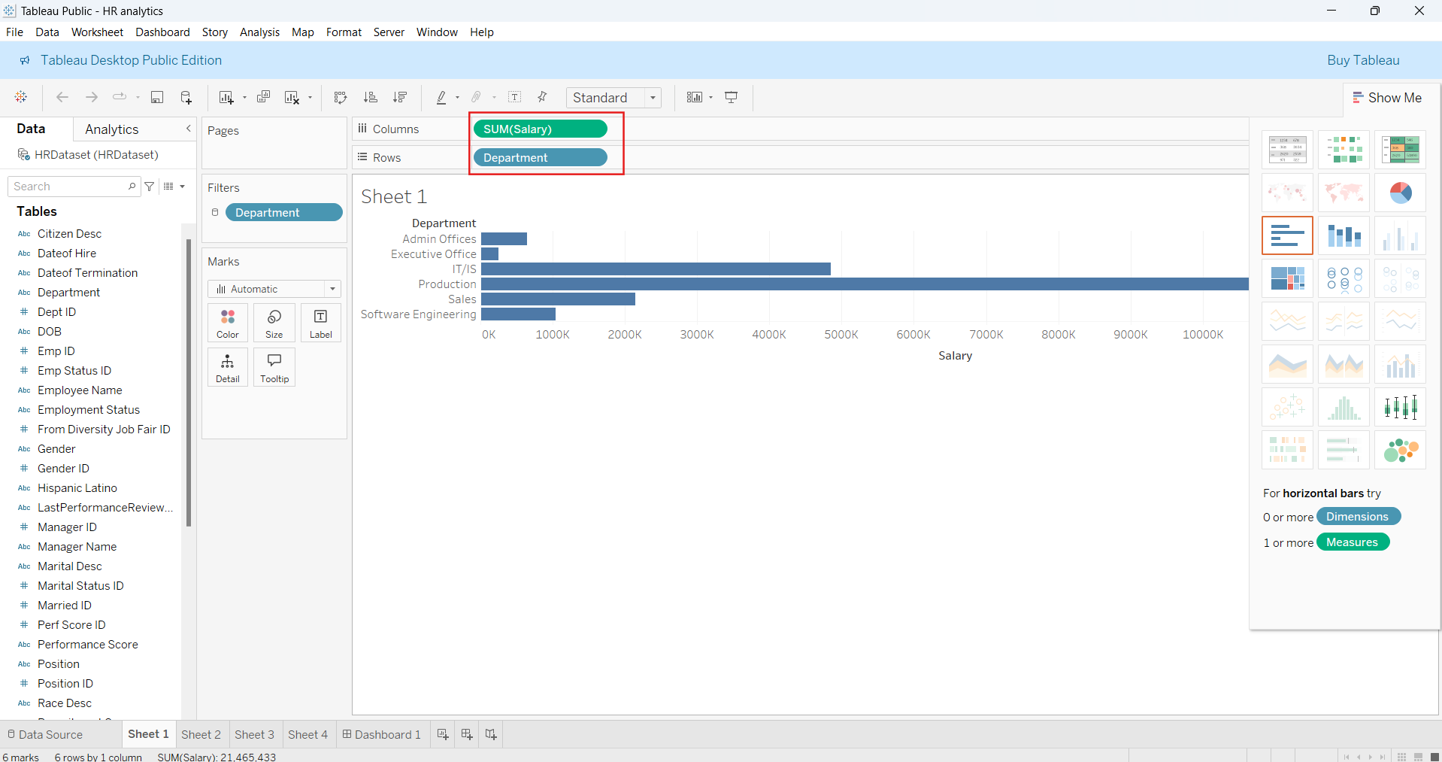
DEPARTMENT SALARY
Here, the worksheet is opened.
Here, we drag department in rows and salary in columns.
We can click the visualization in the right side.

Slide 4
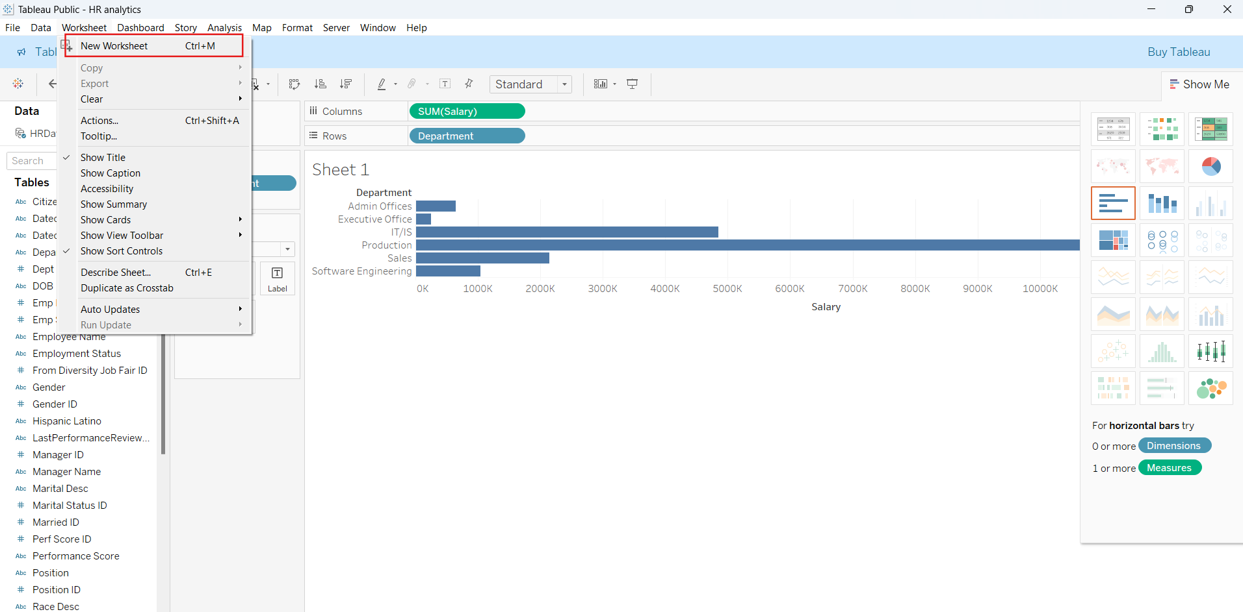
NEW WORKSHEET
Next click worksheet → New worksheet.
So we get the sheet 2 to work.

Slide 5
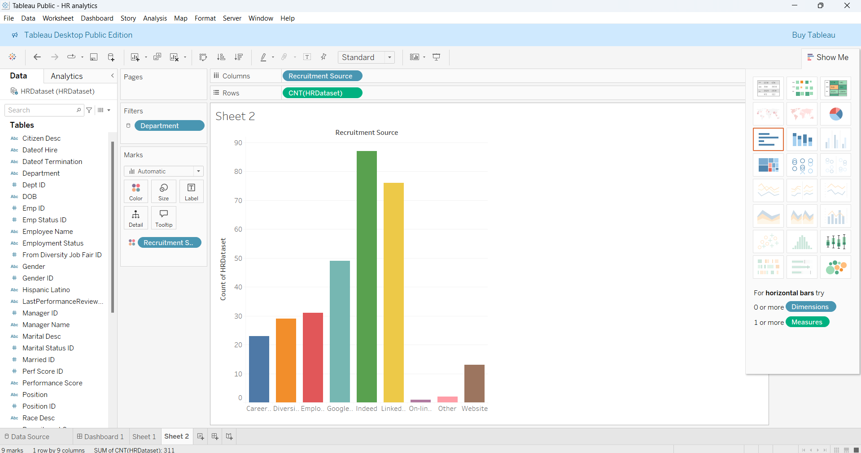
RECRUITMENT SOURCE OF HR COUNT
In sheet 2, we drag recruitment source in columns and count of HR dataset in rows.
We can click the visualization in the right side.

Slide 6
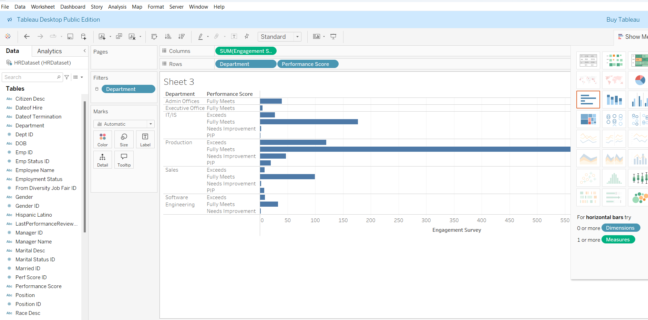
PERFORMANCE SCORE AND ENGAGEMENT SURVEY
In sheet 3, we drag engagement survey in columns and department and performance score in rows.
We can click the visualization in the right side.

Slide 7
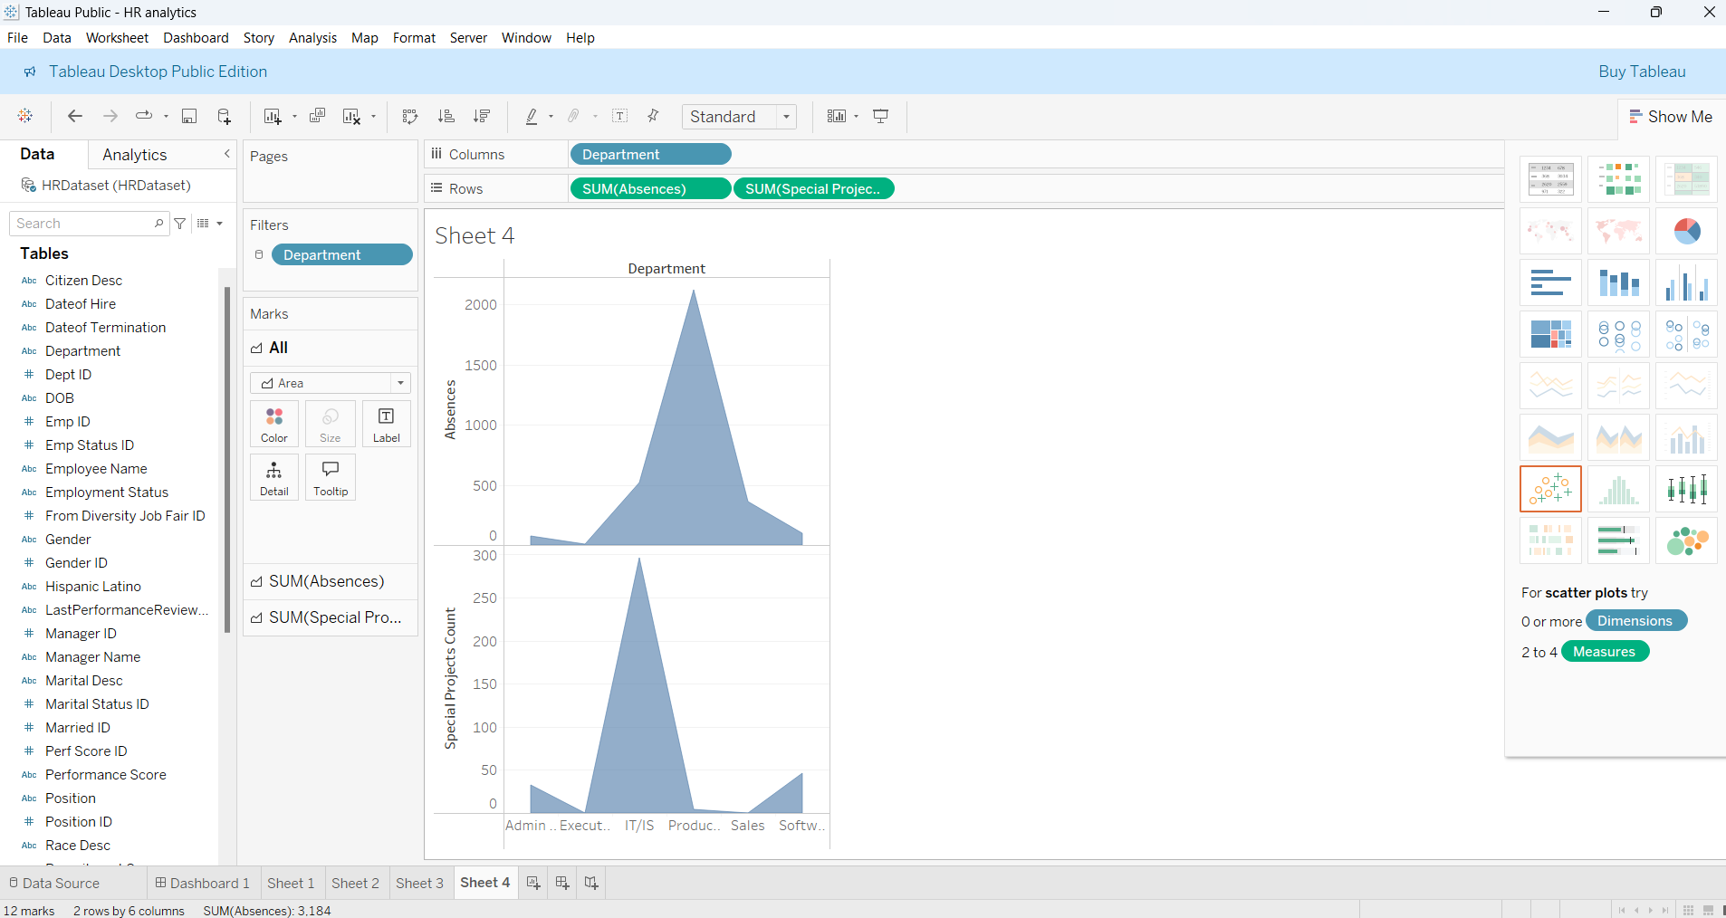
ABSENCES AND SPECIAL PROJECT COUNTS
In sheet 4, we drag, department in columns and sum of absences and sum of special project counts in rows.
We can click the visualization in the right side.

Slide 8
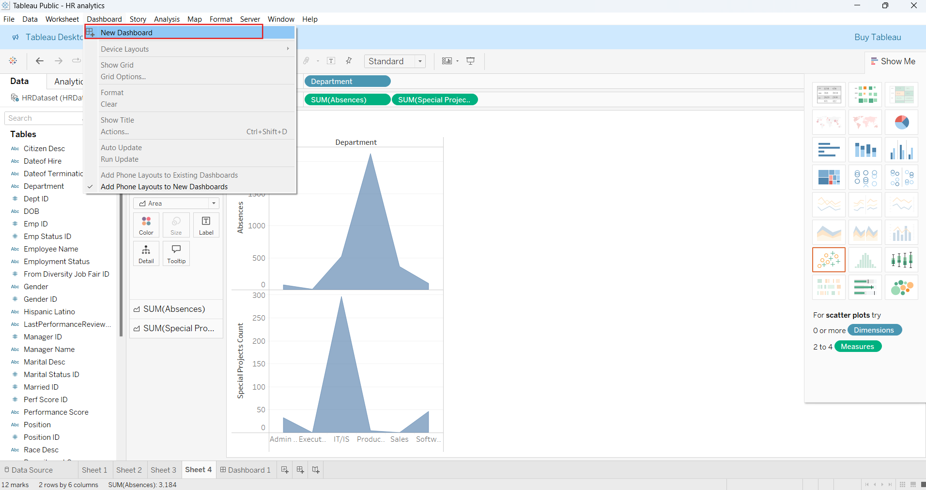
CREATE DASHBOARD
Now, we create a dashboard.
Click dashboard → New dashboard.

Slide 9
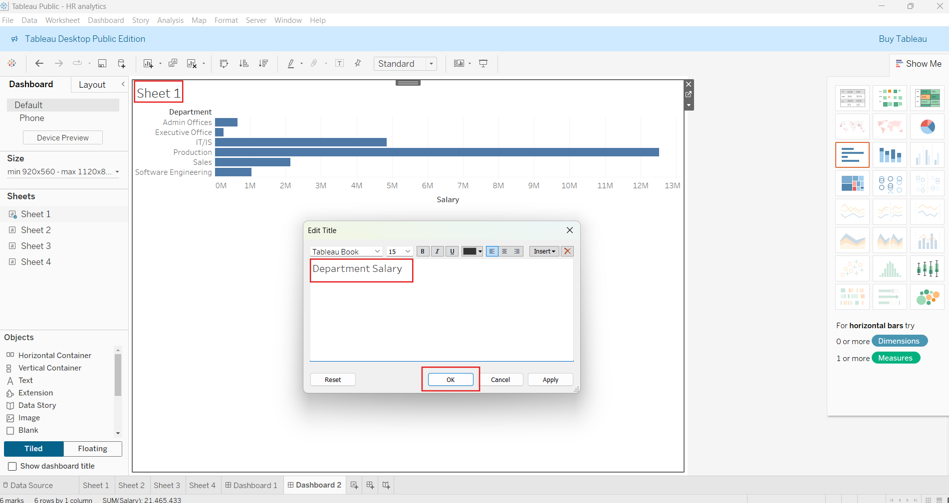
CHANGE TITLE
Here, we drag the sheets to the space.
Double click the title and change the title of the visualization.

Slide 10
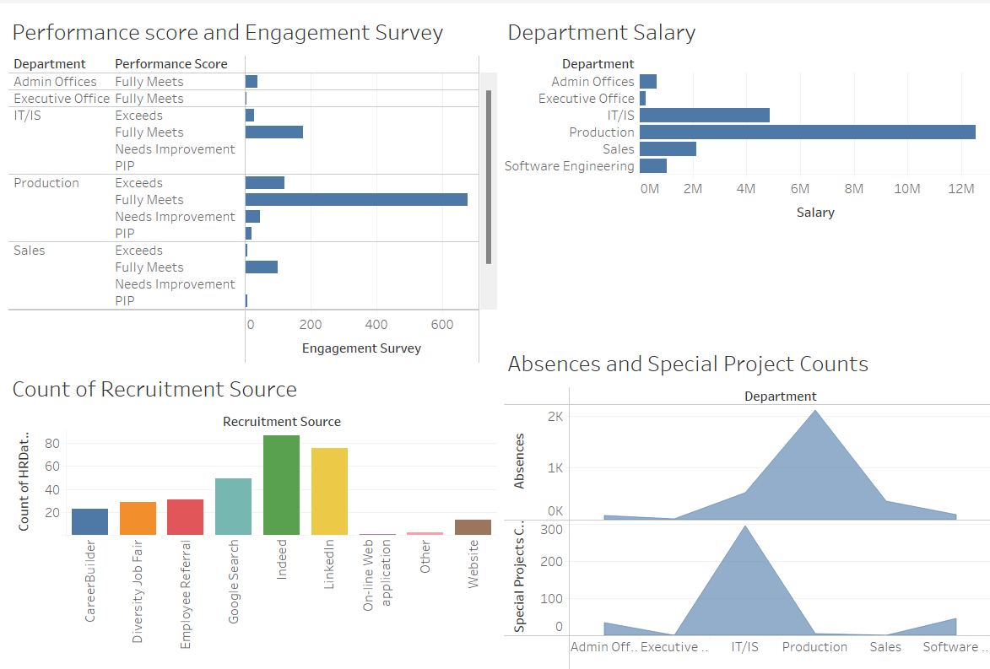
Here, all the sheets are dragged in workspace and the title is changed.

Slide 11
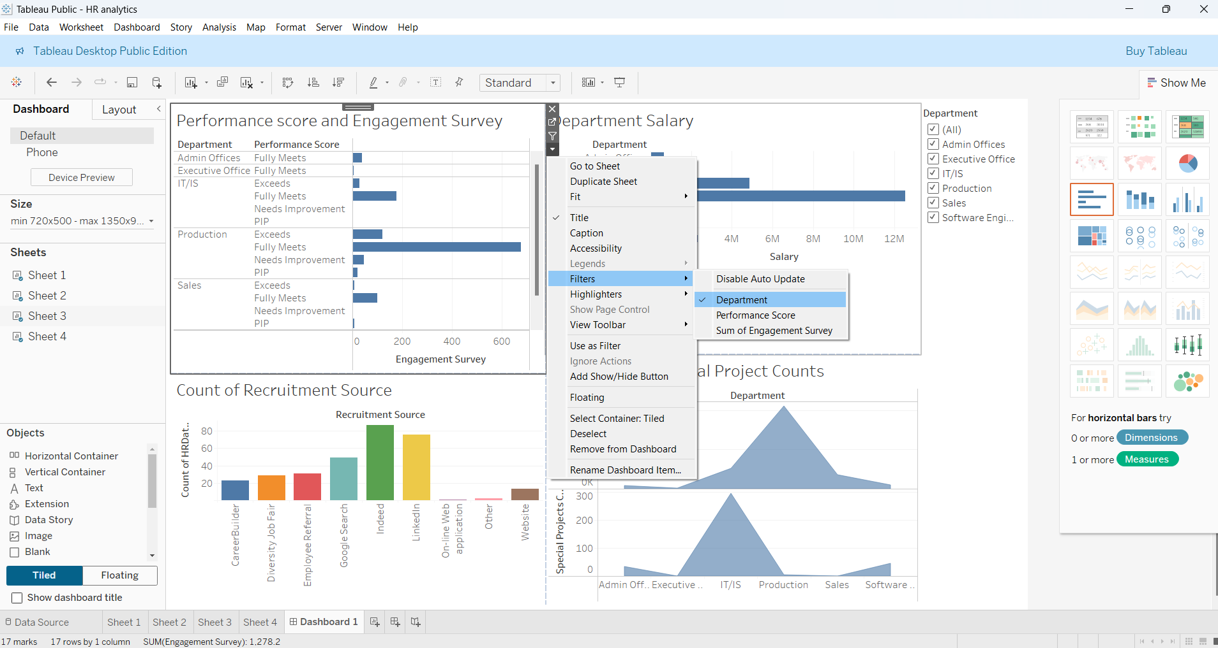
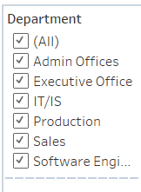
FILTERS
Next, click anyone of the visualization.
Click dropdown arrow → Filters → Department.

Slide 12
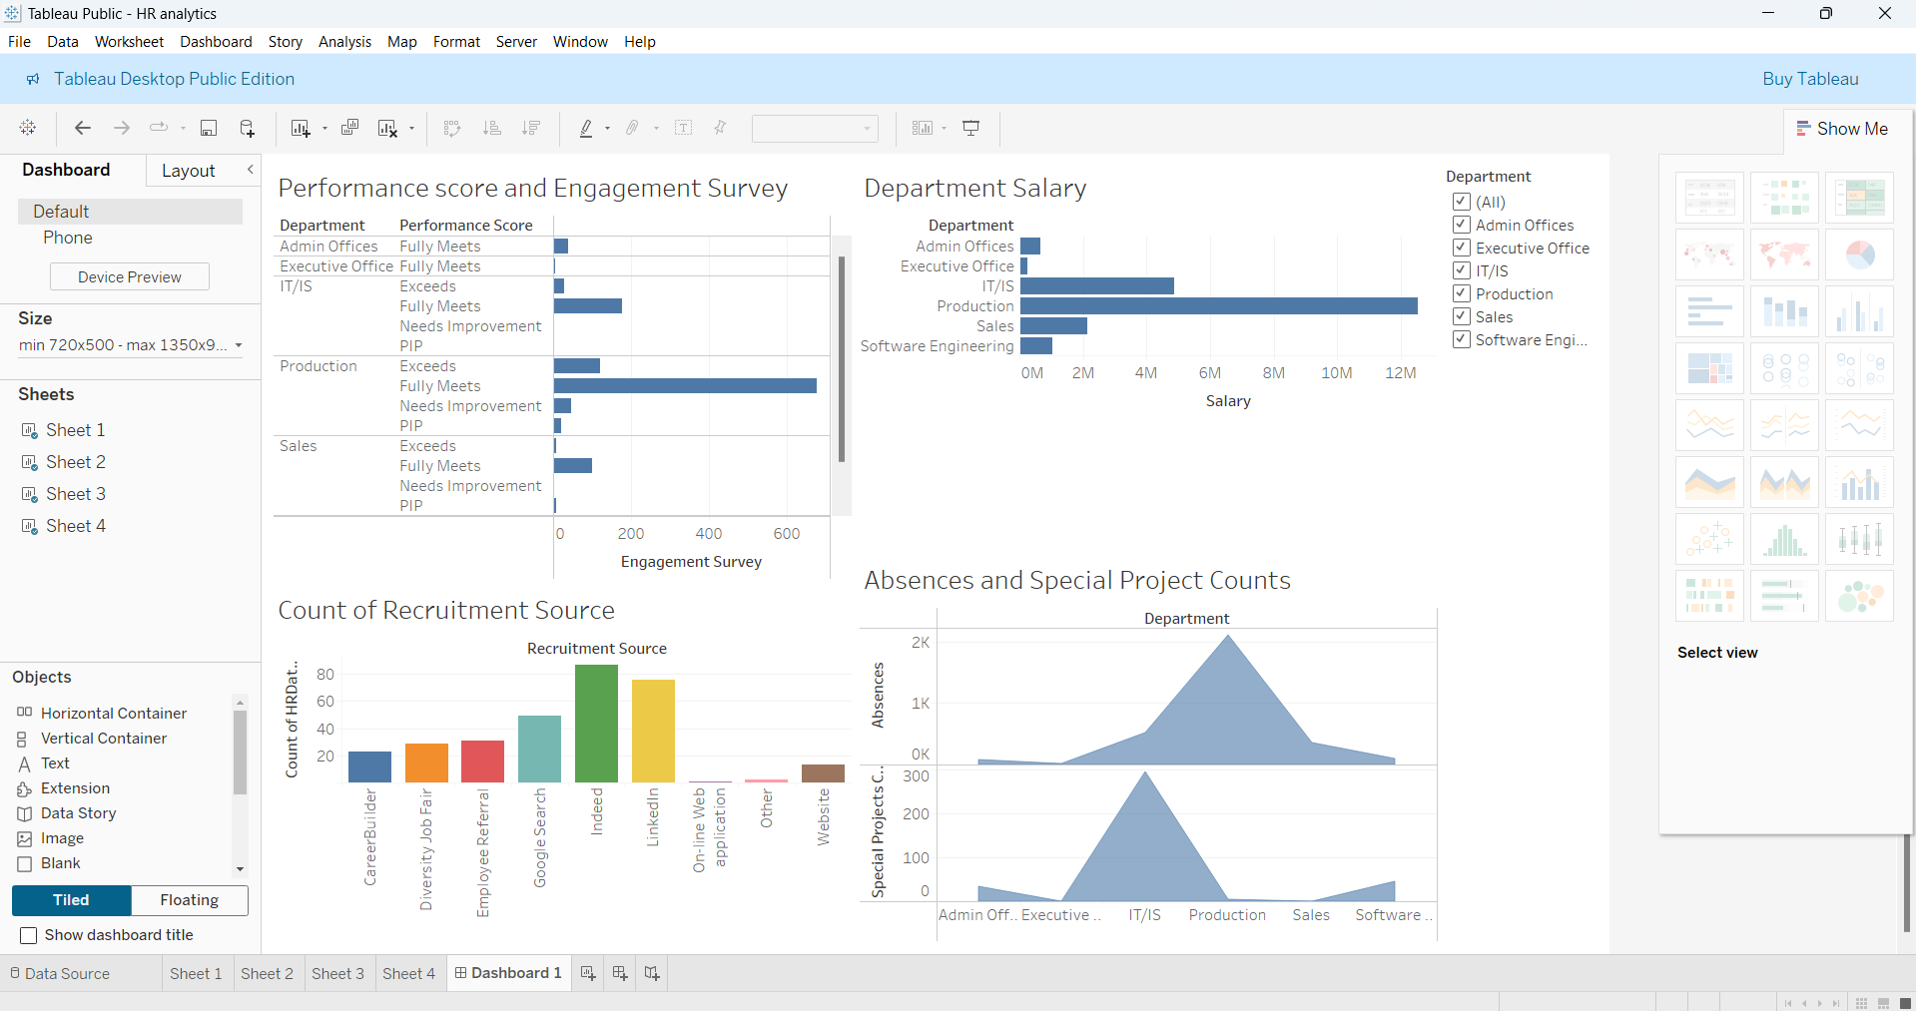
DASHBOARD
Here we got the dashboard.

Slide 13
THANK YOU!

